Slide 1
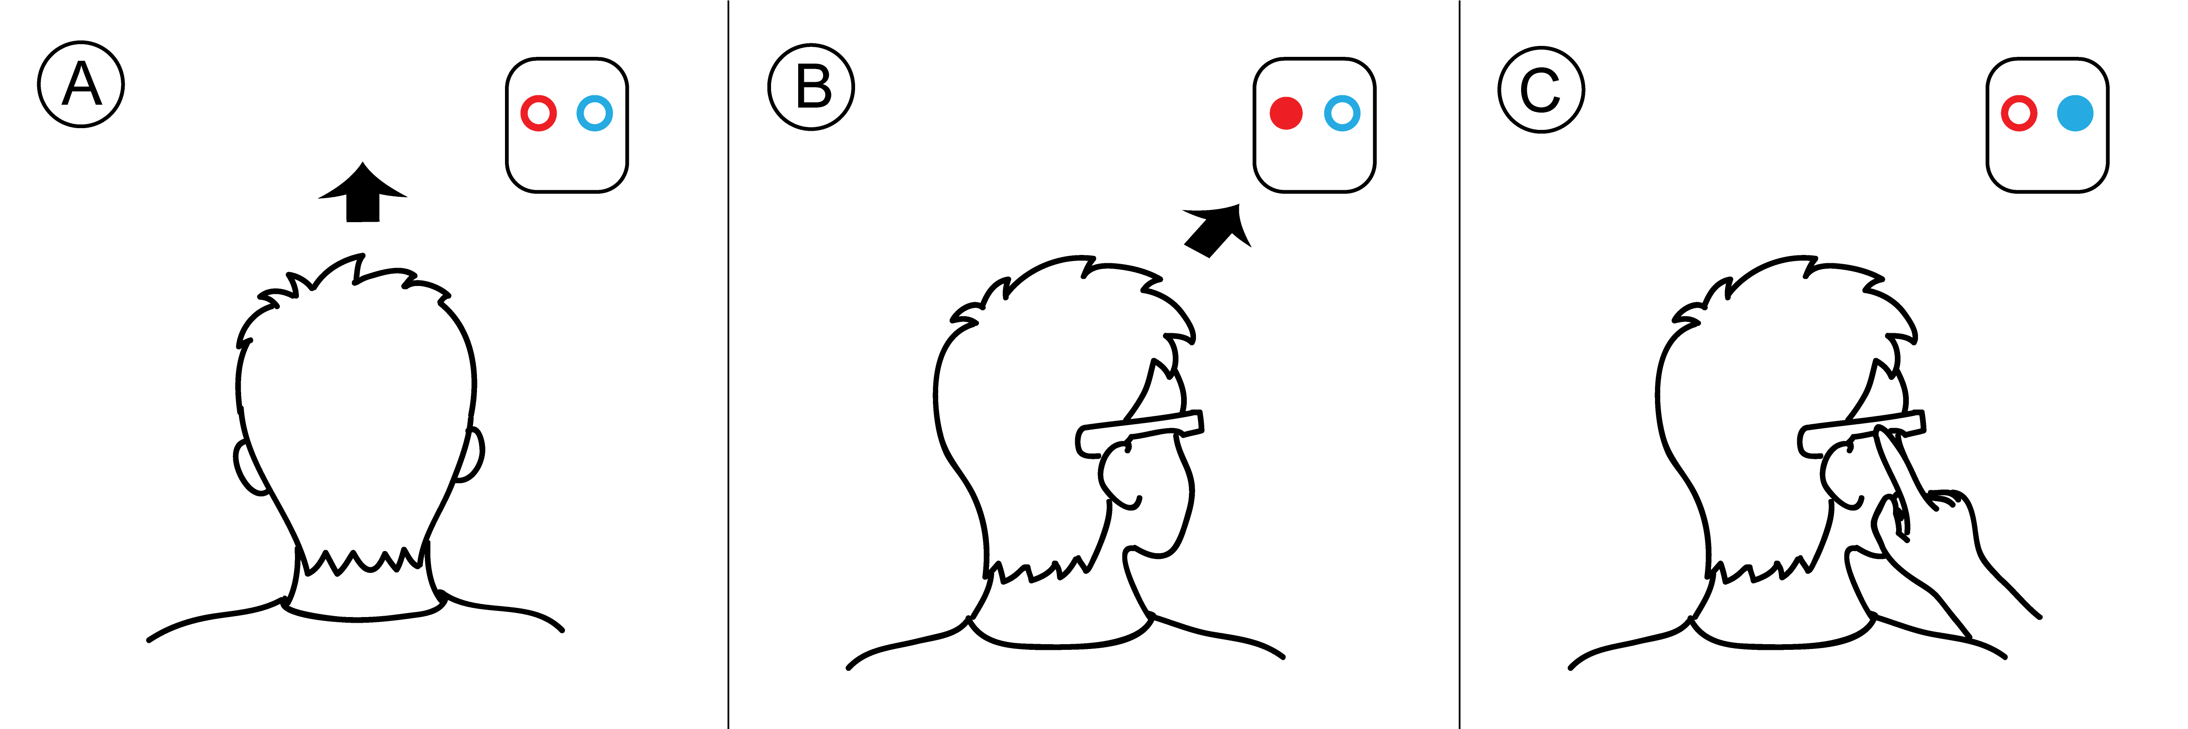
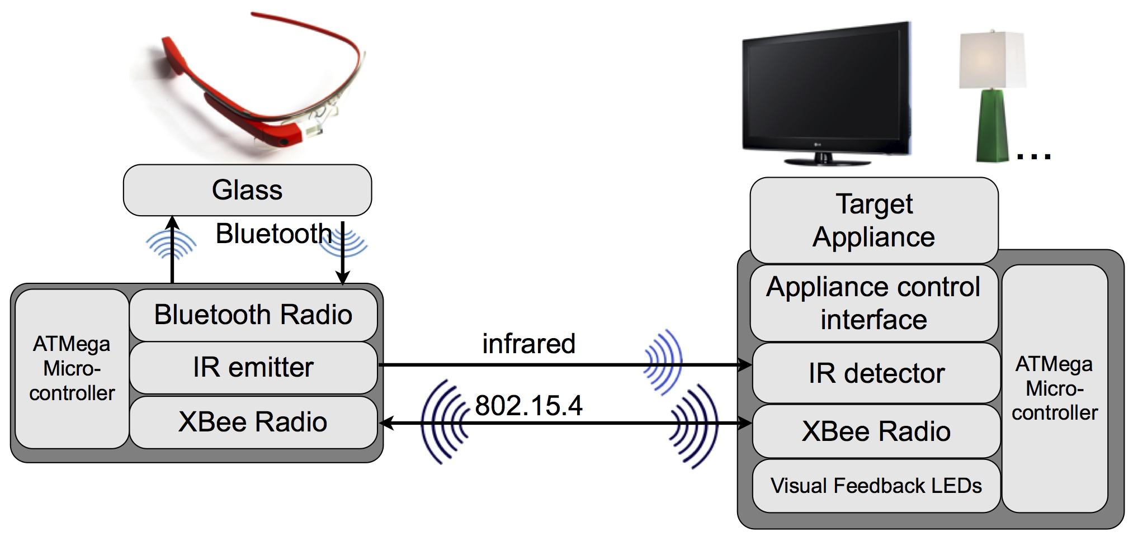
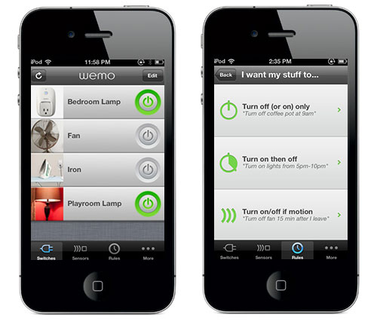
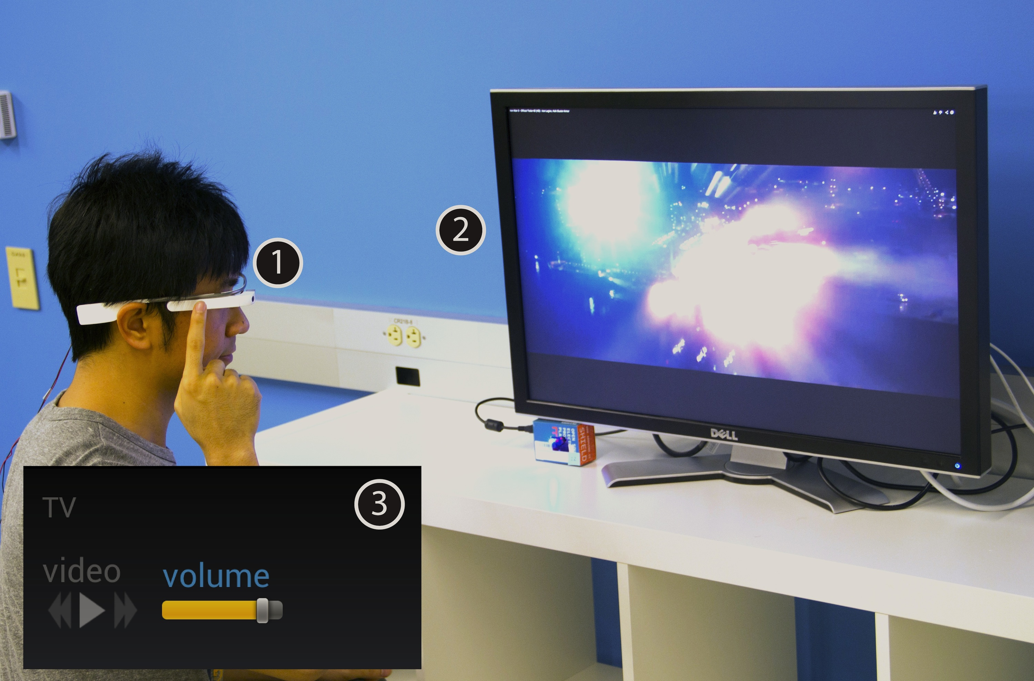
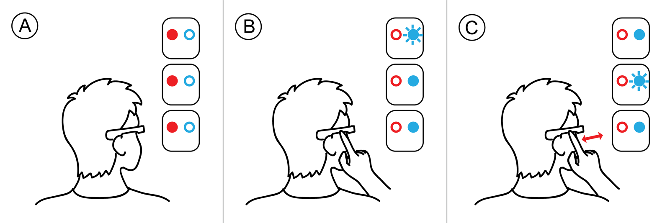
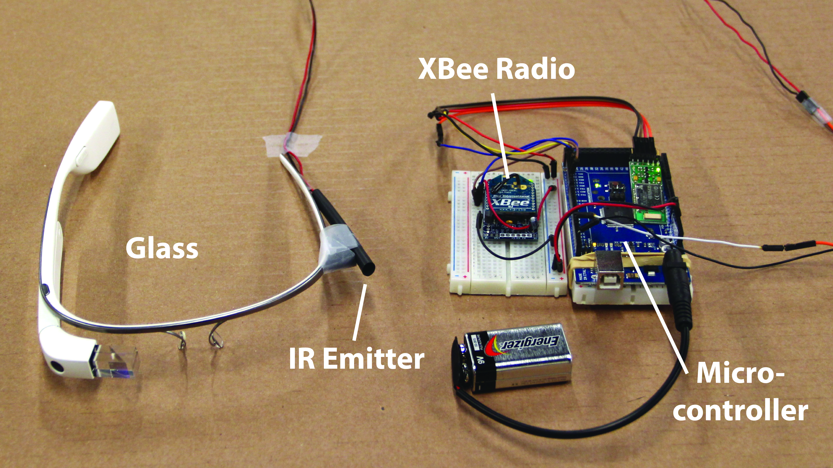
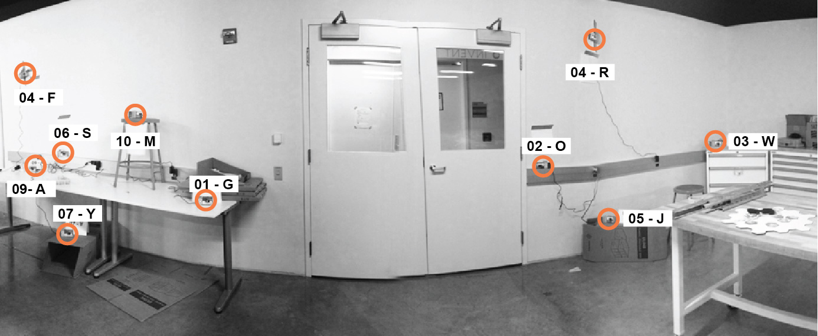
Context Menu for the Real World: Controlling Physical Appliances Through Head-Worn Infrared Targeting
a commer- cial wearable computing device, Google Glass, with a narrow-beam IR emitter for this purpose.
CITRIS
Poster
Session
Motivation
Internet of Everything -- what would be the good way to interact with smart things?
Existing solutions -- Naming?
Scoping? Always-available?
Our approach
Using an augmented head-worn device, users can control smart home appliances with head orientation targeting. A near-eye display then shows an appliance control UI, which users navigate through multi-touch gestures.
Interaction in Illustration
When users turn towards a controllable appliance (A→B), the appliance shows immediate visual feedback (red LED) (B). Users confirm that they wish to connect to this appliance with a tap (C) which triggers connection feedback (blue LED) on the appliance.
When multiple appliances are within range, they all have red LEDs illuminated for feedback (A). When users initiate connections, all target appliances toggle on blue LEDs while the currently selected one blinks (B). Swiping on the touchpad traverses among responding appliances (C).
System Architecture and prototype
In our system architecture, selection is initiated through infrared but confirmed over 802.15.4. This permits wearers to move their head freely after connecting to an appliance. In the research prototype, users have to carry an additional microcontroller board that marshals messages between Glass’ Bluetooth radio and IR/802.15.4.
Evaluation
A user study (14 participants, 10 wireless nodes spread across 141 SDH) was taken to measure the time it takes to connect and control a target in two modes – IR mode and list mode. We also asked participants to experience a smart home scenario for qualitative feedback.
User study environment in 141 SDH.
IR outperforms list, especially when most of the interaction doesn’t involve disambiguation.
With the increasing of targets, the time increases roughly linearly.
Users prefer IR in general.

